Slide 1
CO2 PREDICTION MACHINE LEARNING MODEL ANCA & SEB

Slide 2
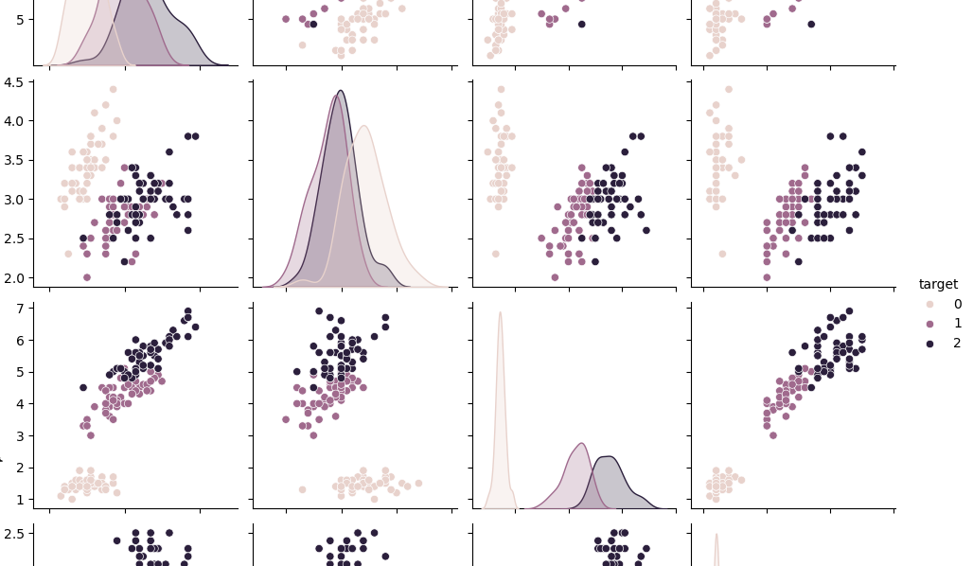
CONTENT
Project Overview
Data Selection and Preparation
Feature Engineering and Selection
Model Building and Evaluation
Hyperparameter Tuning and Model Optimization
Key Findings and Insights
Real-World Application and Impact
Challenges and Learning
Future work and improvements

Slide 3
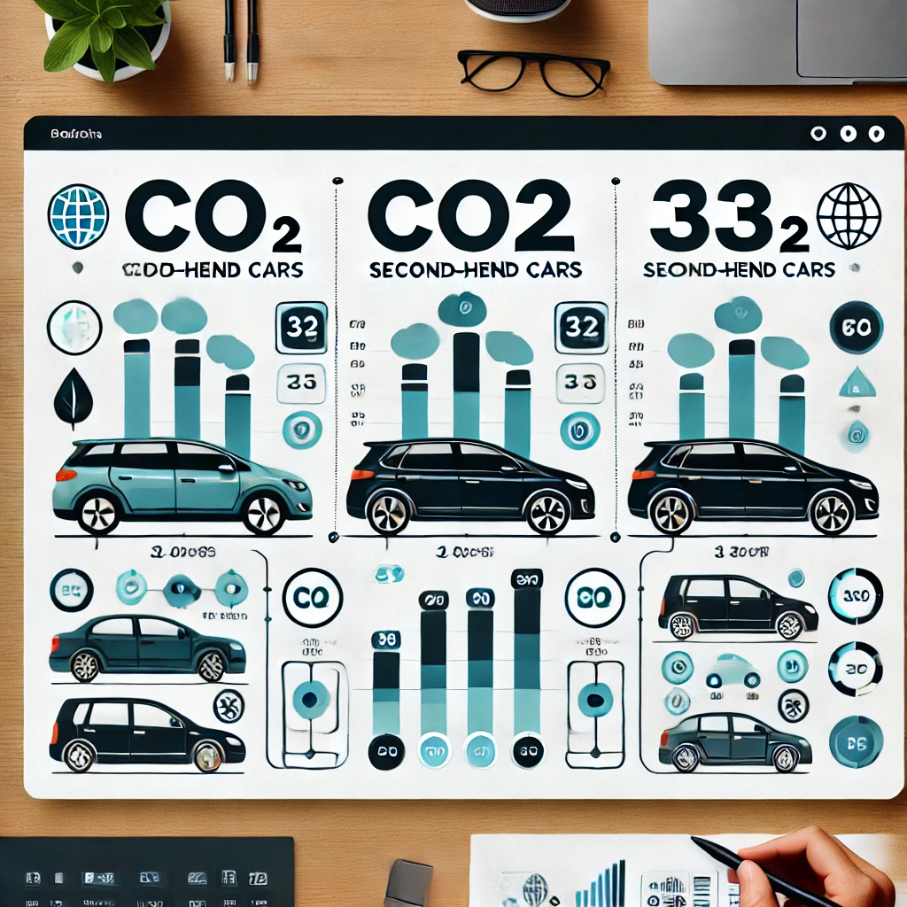
PROJECT OVERVIEW
Machine learning Project based on a Kaggle data set on CO2 Emissions according to car models.
Objective: Create a model capable of prediction CO2 emissions for second-hand cars.

Slide 4
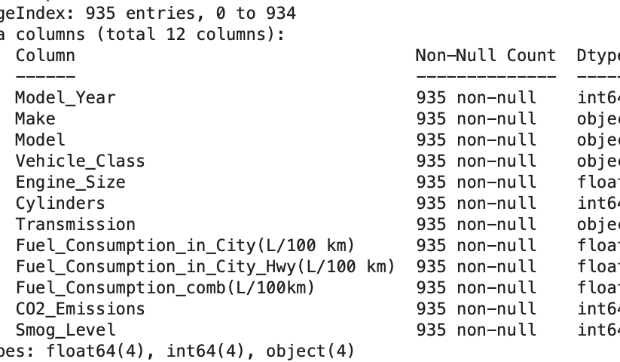
DATA SELECTION AND PREPARATION
Kaggle Data Set with 935 rows and 12 Columns
Data Cleaning included drop null-values, duplication-check, removed unnecessary columns (Model year), also tried to split the transmission and vehicle class columns (which might have not been a great idea cf. challenges).

Slide 5
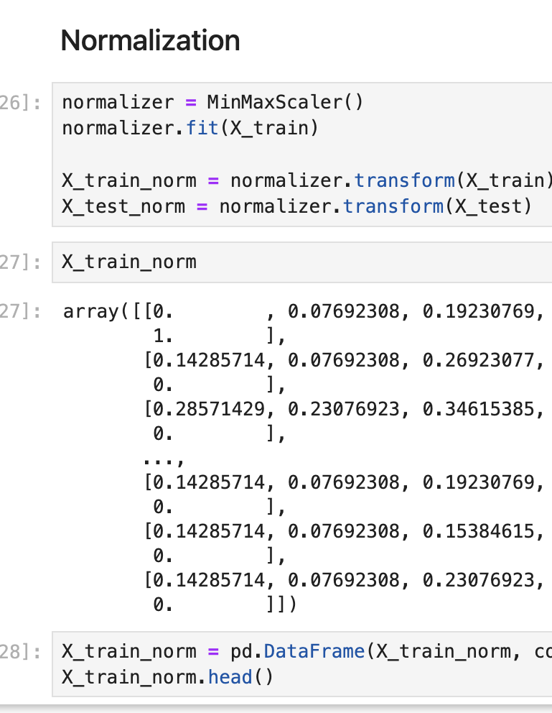
FEATURE ENGINEERING AND SELECTION
Kept close to the proposed class and lab model
First divided into feature and target
Perform train-test Split
Feature was then split into Numerical and categorical
Categorical: one hot encoding
Numerical: scaling and normalized

Slide 6
MODEL BUILDING AND EVALUATION
∙ High Accuracy: The Decision Trees model achieved the highest accuracy with an R² score of 0.9745.
∙ Precision Metrics: Mean Absolute Error (MAE) was 7.708, and Root Mean Squared Error (RMSE) was 13.338, indicating precise predictions.
∙ Model Effectiveness: All models demonstrated strong capabilities in predicting CO2 emissions based on vehicle characteristics.
∙ Best Performance: The Decision Trees model provided the best overall performance among the models tested.
KNN | Linear Regression | Decission Trees
0.7836 | MAE 7.708 RMSE 13.338 R2 score 0.9558 | 0.9745

Slide 7
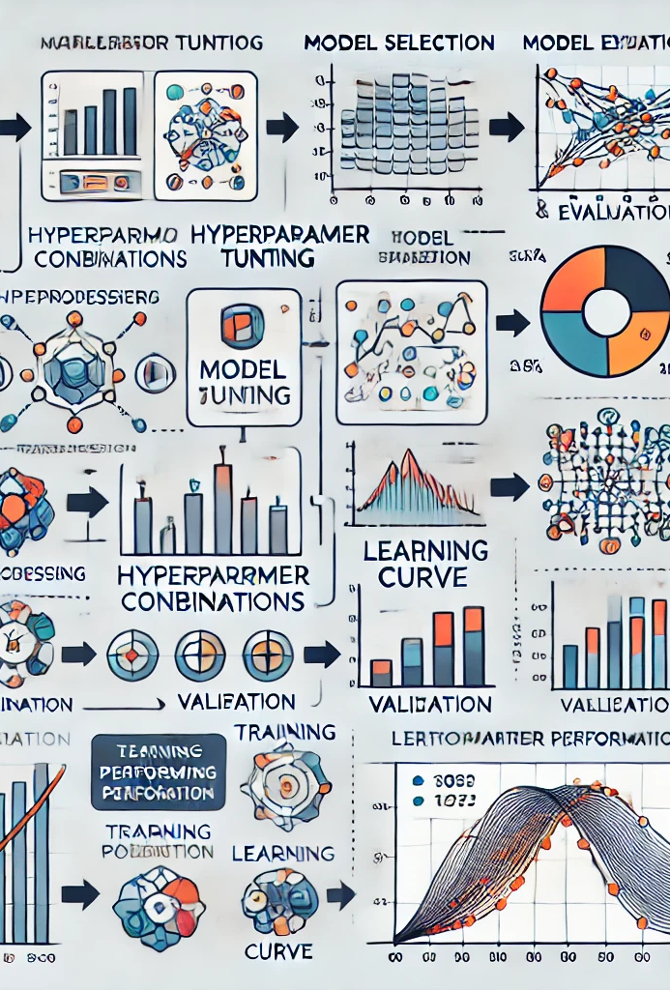
HYPERPARAMETER TUNING AND MODEL OPTIMIZATION
Following the lesson example we used:
Bagging and pasting
Random Patches
AdaBoost
Gradient boosting
Grid Search

Slide 8
KEY FINDINGS AND INSIGHTS
Model Comparison
While ensemble learning improve the model, the original data was good enough that we already had very high results with the the Decision Trees model that yelled around 97% with the KNN-model being the weakest at 0.78.
Among the models tested, the AdaBoost model. It provided the best balance of accuracy and interpretability, with the lowest Mean Absolute Error (MAE) and Root Mean Squared Error (RMSE) scores.
Interestingly, parallel computing the models on our computers yielded slightly different results.
Future Directions
Further refinement of the models could include integrating more advanced machine learning techniques, such as ensemble methods or deep learning, to improve prediction accuracy. Additionally, exploring the impact of emerging technologies like autonomous driving on CO2 emissions could provide valuable insights.

Slide 9
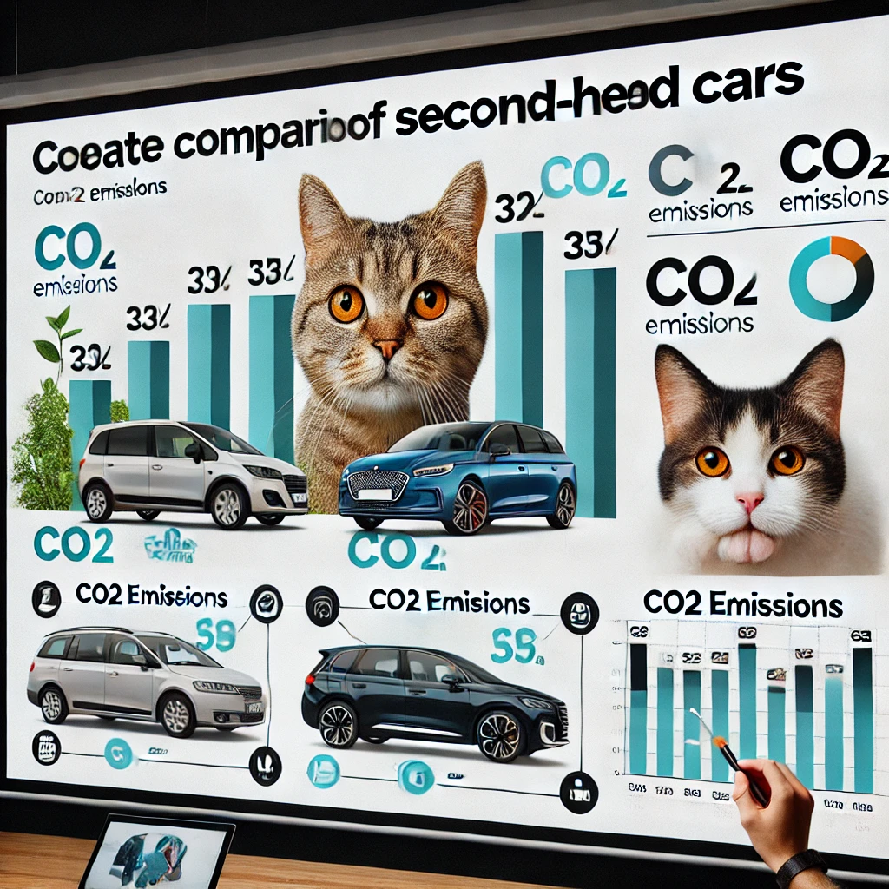
REAL-WORLD APPLICATION IN SECOND-HAND CAR MARKETS
Environmental Impact: Accurate CO2 emission data helps consumers choose lower-emission vehicles, reducing overall carbon footprints.
Informed Decision-Making: Buyers can compare vehicles based on emissions and fuel efficiency, making more informed purchasing decisions.

Slide 10

CHALLENGES AND LEARNING
Github
Parameter tuning and ensemble method were not totally clear to us.
And finally, we were not sure if our model would actually help the use case (the actual selection of a second-hand car)

